Slide 1
Welcome to Persuasion: COM 318
Dr. Susan E. Morgan
Professor
Brian Lamb School of Communication

Slide 2
Today’s Class
Introductions
What are the goals of the class?
What are the books for this class?
How many exams? Is there a paper?
Is attendance required?
What’s the policy on using computers & phones in class?
How can I get extra credit?
How can I be sure to get a good grade?
Syllabus quiz (5 points): September 3rd.

Slide 3
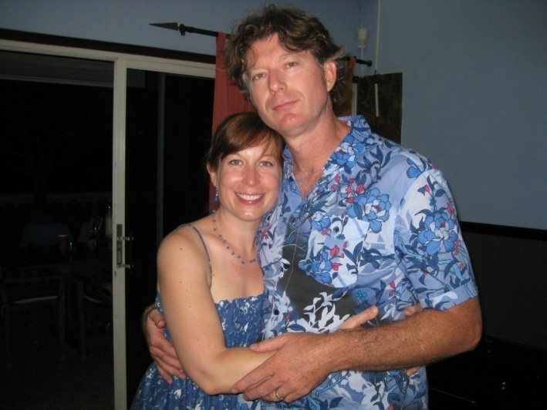
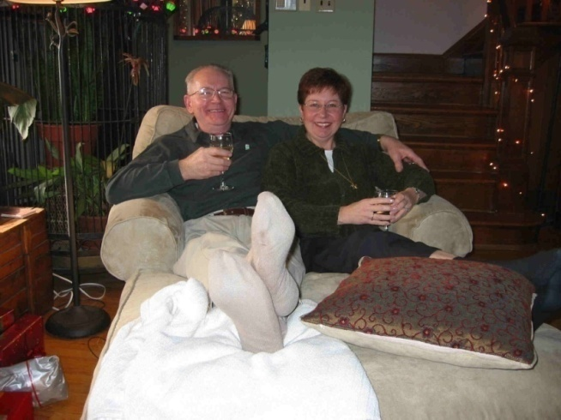
Dr. Susan E. Morgan
Education/Background
B.A. Communication, U of Massachusetts; MA & Ph.D., U of Arizona.
Professor, Purdue (2005- present)
Research Interests
The design and evaluation of health campaigns
Intercultural communication
Fun Facts
$9+M in federally funding, 50 publications, 1 book, 50 conference papers and presentations… and yet watches America’s Next Top Model.
Is married to Dr. Harrison but is neither Mrs. Harrison nor Mrs. Morgan!
Is glad her father changed their last name from “Mochnacs” but is still close to her Hungarian family.

Slide 4
Goals of the Class
1. To learn about the major areas of study in the field of persuasion.
2. To provide opportunities for the analysis of persuasive techniques.
3. To understand how theories of persuasion can aid the comprehension of everyday circumstances.

Slide 5


Do You Have to Buy the Books?
Only if you want to do well!
Cialdini, R. B. (2009). Influence: Science and Practice, 5th Edition. New York: Harper Collins.
Gass, R.H. & Seiter, J.S. (2013). Persuasion, Social Influence, and Compliance Gaining, 5th Edition. Allyn & Bacon. You can also use the 4th edition. Text is available in e-format as well as print.
These text books are REQUIRED for this course. For both books, test questions and lectures will focus on material contained in these specific editions of each book. We do not have access to information about changes to the texts from editions prior to the 4th edition of G&S.

Slide 6
What are the Major Requirements?
Three (non-cumulative) exams (100 points each).
Research paper (150 points)
Activities and civility (50 points)
Total of 500 course points

Slide 7
Is Attendance Required?
Yes.
You can miss two classes without penalty.
If you miss an exam or an assignment, you will need to get a verified absence letter from the Dean of Students’ office.
When you attend class:
No technology in the classroom: No use of laptops, phones, etc. PowerPoint lectures available 24 hours in advance.
Violation of technology policy will result in a grade penalty (1/2 letter grade). No “warnings.”

Slide 8
What are the exams like?
3 exams, 33- 50 multiple choice questions.
Questions are not designed to be trick questions. Try not to over-think them.
No make-up exams, even for really, really, really good reasons.

Slide 9
Is There a Paper?
One research paper, worth 150 points.
12-15 pages, double-spaced.
At least 8 scholarly sources.
APA formatting style.
You will select one (and only one!) theory and then apply it to some area of interest to you.
Please come talk with me about your paper topic by the end of September.
Submit your paper via Blackboard AND SafeAssign

Slide 10
Activity points
Includes activities, quizzes, discussions. Worth 50 points.
Not violating the technology policy and communicating in a civil fashion at all times will earn you all remaining points.

Slide 11
Can You Get Extra Credit?
Yes, but you should do it early to make sure you can get in.
Please review the instructions before you sign up for studies. To view the instructions go to http://www.cla.purdue.edu/communication/undergraduate/rps.shtml
You can sign up to participate in studies by logging in to http://purdue-comm.sona-systems.com/
We will be automatically notified at the end of the semester of who has participated.
Extra credit is not a right. If you fail to follow instructions or you wait too long to participate in a study, please do not complain.

Slide 12
How Can I Get a Good Grade?
Come to class (unless you are very ill) and pay attention. Participate in discussion. Take good notes.
Keep up with course readings. Have the assigned readings done before class.
Study hard for the exams. Have a study partner who is also a serious student.
Be professional and civil in all of your communication with your fellow students and me. Don’t violate the technology policy.
Follow all of the criteria for the paper requirements. Talk to me in advance if you don’t understand any part of the assignment.
Take advantage of the extra credit research opportunities well in advance of the end of the semester.

